Slide 1
Machine Learning

Slide 2
Inhalt
Classification
Regression
Observations & Features
Machine Learning
Overfitting/Underfitting

Slide 3
Classification
Classification
Input
Class

Slide 4
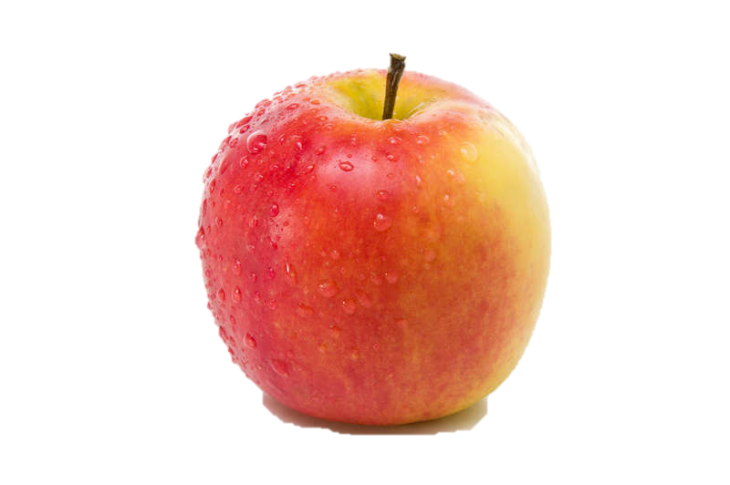
Classification
Classification
Bsp.:
Input
Class
Apfel

Slide 5
Classification
Classification
Bsp.:
Input
Classifier
Class
Apfel

Slide 6
Regression
Regression
Input
Output

Slide 7
Regression
Regression
Bsp.:
Input
Output
30 °C
600 Eiskugeln

Slide 8
Regression
Regression
Bsp.:
Input
Function
Output
30 °C
600 Eiskugeln

Slide 9
Vergleich
Classification
Bsp.:
Input
Classifier
Class
Apfel
Regression
Bsp.:
Input
Function
Output
30 °C
600 Eiskugeln

Slide 10
Machine Learning
Classification
Input
Classifier
Class
Machine Learning (Supervised Learning)
Trainings Daten
Ml Algorithmus
Regression
Input
Function
Output

Slide 11
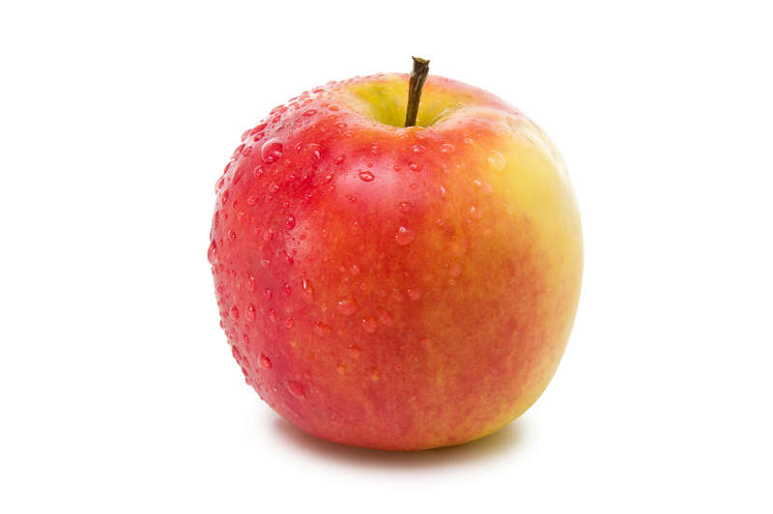
Observations & Features
Input (Observation)
Feature Extraction
Features
Form
Farbe
…

Slide 12
Konzept
1: Training
Input (Observation)
Feature Extraction
Features
Machine Learning
Gewünschter Output
2: Prediction
Classifier/
Function
Input (Observation)
Feature Extraction
Features
Predicted Output

Slide 14
Quellen
http://stamfordresearch.com/scikit-learn-perceptron/
http://stamfordresearch.com/python-perceptron-re-visited/
http://scikit-learn.org/stable/auto_examples/model_selection/plot_underfitting_overfitting.html
https://de.slideshare.net/rahuldausa/introduction-to-machine-learning-38791937
https://de.wikipedia.org/wiki/Einfache_lineare_Regression

